Slide 1

Efficent and secure balance for RSU and V2V in VAENTS
Li Dongbo(Trevor)
202118010428
Cleof(2022) Vehicular Blue Background. Available at:
https://www.51pptmoban.com/zhuti/12290.html(Accessed: 1 April 2024).

Slide 2
Analysis of Malicious Node Identification Algorithm of Internet of Vehicles under Blockchain Technology: A Case Study of Intelligent Technology in Automotive Engineering
A Noval and Efficient Three-Party Identity Authentication and Key Negotiation Protocol Based on Elliptic Curve Cryptography in VANETs
Secure Authentication Schemes for Vehicular Adhoc Networks: A Survey

Slide 3

Generator :
Paper 1
System Initialization: The registry center generates a large prime number and constructs an elliptic curve, selecting a generator of order p. It then chooses a random number as the system’s master key and generates the public parameter.
Roadside Unit Registration: Roadside units register at the registration center to provide network resources. The registration center calculates specific values using the hash function and the master key to authenticate the roadside units.
Vehicle Registration: Vehicle users register to acquire access rights4. The process involves generating random numbers and hash values to create authentication information, which is then sent to the vehicle terminal.
Authentication and Key Agreement: This phase involves several steps where the vehicle and roadside unit compute and exchange messages encrypted with their respective keys. The registry center verifies the authenticity of these messages and confirms the establishment of a secure session key.
Password Upgrade: The protocol includes a mechanism for vehicle users to update their passwords independently without communicating with the roadside unit or the registry center, enhancing security.。

Slide 4
Paper 2:
CA stands for the Certification Authority, which is responsible for managing the registration and authentication of RSUs (Roadside Units) in the blockchain-based consensus mechanism for VANET
POS1 algorithm refers to the new consensus mechanism introduced for VANET, where RSUs participate in the selection of bookkeeping nodes under this algorithm. RSUs need to register with the CA and submit a deposit to become candidates for the bookkeeping selection process The algorithm involves creating energy value statistics for RSU candidates, eliminating those below a set threshold, and determining the equity value based on the assets or energy owned by the node The mechanism also involves resetting accounting functions at specific intervals and selecting bookkeeping nodes accordingly The consensus mechanism POS-I involves a series of steps where RSUs request to participate in the selection of bookkeeping nodes, deposit energy, calculate stake values, and ultimately select a committer peer based on stake values The mechanism aims to ensure that RSUs receive enough energy returns to continue smoothly in the network

Slide 5
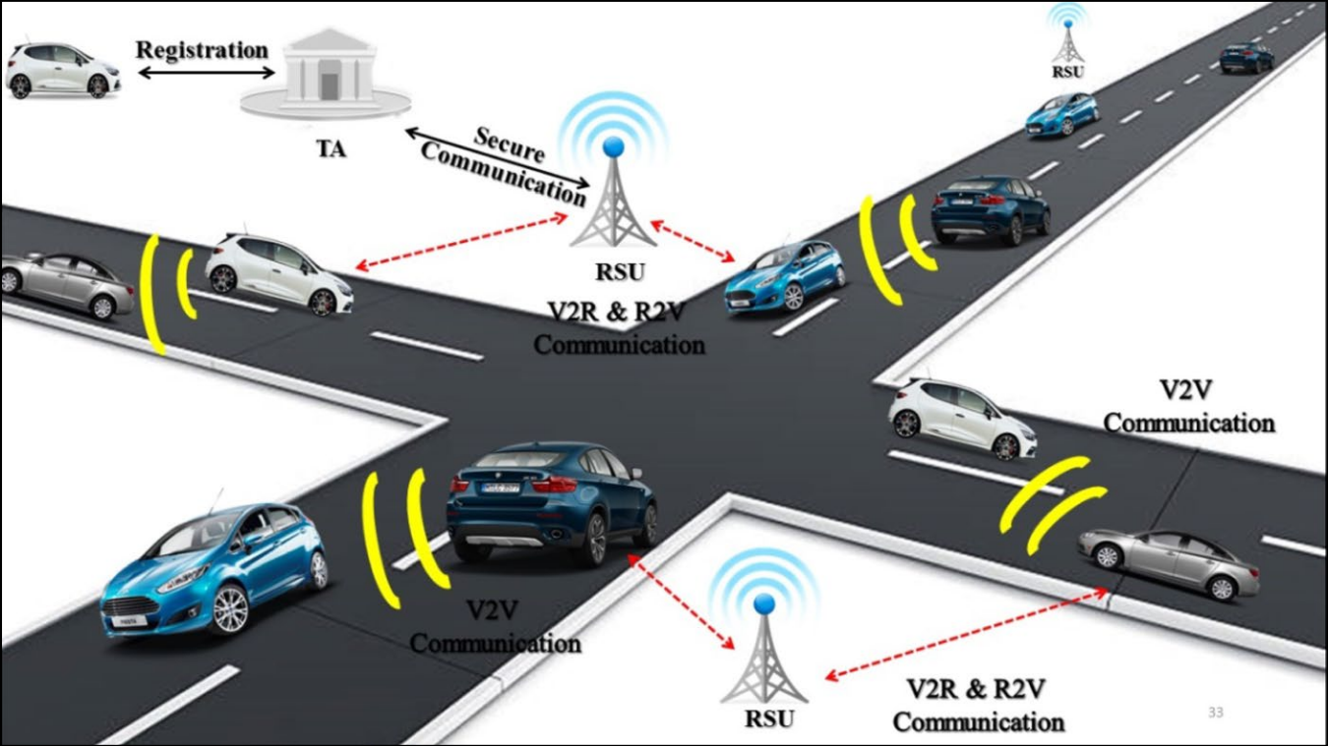
VANETs include, Vehicular to Vehicular (V2V) Road-Side Units (RSU) and Trusted Authorities (TA)
DAPPA (Identity-Based Aggregate Signature Scheme). Aggregate Signatures:
multiple signatures are combined into a single signature for efficient verification of multiple messages simultaneously. Tamper-Proof Devices: The scheme addresses challenges related to ideal tamper-proof devices by using realistic tamper-proof devices, enhancing the security of the system. Combination of Techniques: DAPPA combines key-based, certificate-based, and signature-based authentication techniques to provide a comprehensive approach to authentication in VANETs. Efficiency: By aggregating signatures and reducing the need to verify dividual messages,
DAPPA aims to reduce storage requirements and improve efficiency in message verification.
Jenefa, J., Mary Anita(2022) Secure Authentication Schemes for Vehicular Adhoc Networks: A Survey. Available at:
https://link.springer.com/article/10.1007/s11277-021-09118-3#citeas (Accessed: 1 April 2024).

